Slide 1
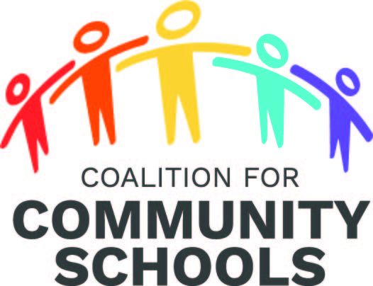
Community Schools Research Practice Network Webinar Series
Community Schools: People and Places Transforming Education and Communities
Wednesday, July 17, 2:00 – 3:00 PM Eastern Daylight Time

Slide 2
Moderator & Speakers
Moderator:
Reuben Jacobson, Director of Education Policy and Leadership Program, American University.
Speakers:
Kendra Fehrer, Ph.D., Senior Research Associate at the John W. Gardner Center for Youth and Their Communities, Stanford University.
Megan Hester, Director, Education Justice Research and Organizing Collaborative (EJ-ROC), New York University
Lynda Tredway, Senior Associate for the Leaders for Today and Tomorrow Project, IEL
JoAnne Ferrara, Professor, Associate Dean for Undergraduate Advising,
Childhood Education, Manhattanville College

Slide 3
Agenda
Welcome moderator and speakers: Helen Malone, Vice President for Research and Innovation, Institute for Educational Leadership
Opening & Introduction: Reuben Jacobson
Voice for Equity: Youth Leadership in Oakland Community Schools: Kendra Fehrer
Family and Community Engagement: Megan Hester
Community School Leadership: Lynda Tredway
Teacher Preparation: JoAnne Ferrara
Q&A between moderator and speakers
Q&A with audiences

Slide 4
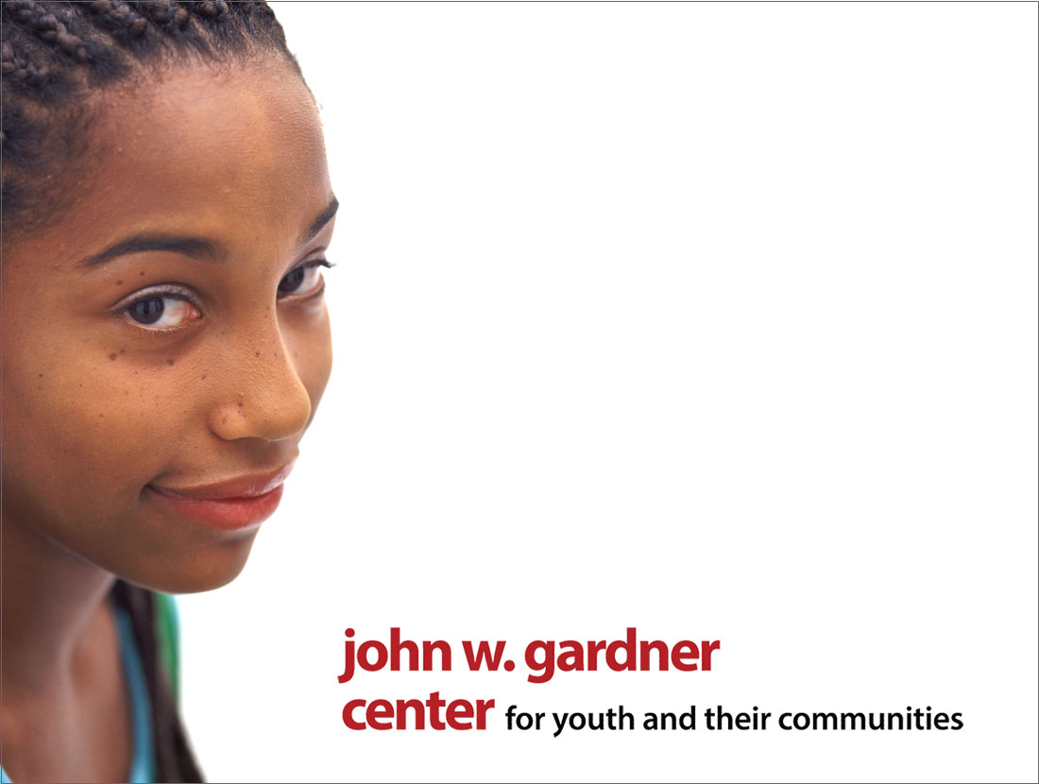
@gardnercenter
Voices for Equity:
Youth Leadership in Oakland Community Schools
Kendra Fehrer & Aurora Lopez
www.gardnercenter.stanford.edu
@gardnercenter
Notes:
Theoretical framing in youth development literature
Foundations in political history of Oakland
OUSD’s journey to become a community school district
Youth participation in OUSD community schools today
Final thoughts

Slide 5

Theoretical Framing
Whole child framework of community schools consistent with youth development lens.
Meaningful participation helps young people learn and thrive.
Youth civic involvement can shape more equitable institutions.
Notes:
Whole child framework of community schools consistent with youth development lens.
Meaningful participation helps young people learn and thrive.
Responsibility helps brain development
Deeper learning when youth are engaged and “have a stake”
Youth civic involvement can shape more equitable institutions.
Youth participation can shape programs, policies, and institutions to be more inclusive and effective.

Slide 6
History
Political mobilizations of the 90’s → “Schools not Jails” and robust youth organizations in Oakland
Youth civic organizations focused on equitable access to quality education
Development of the Standards of Meaningful Student Engagement (MSE Standards)
Notes:
Political mobilizations of the 90’s → “Schools not Jails” and robust youth organizations in Oakland
Youth civic organizations focused on equitable access to quality education
Development of the Standards of Meaningful Student Engagement
With support from a sympathetic superintendent (whose staff were youth organizers)
Built through an intensive, iterative process, building from a collaborative visioning process, and substantiated with a curriculum, derived from (compiled) youth civic organizations.
Re-imagined the role of student government as a force for social justice and social change.
Quote?
State goes into receivership. Truncates the process.

Slide 7
A Community School District
Coming out of receivership, superintendent leads massive district-wide strategic planning process
Youth play prominent roles on key task forces—culture/climate, secondary.
Re-adoption of the MSE Standards.
Notes:
Coming out of receivership, superintendent leads massive district-wide strategic planning process
Youth play prominent roles on key task forces—culture/climate, secondary.
Re-adoption of the MSE Standards.

Slide 8
Youth Participation Today
All City Council Student Union → A-G “Keeping it Real” campaign
Site-level student government → Re-imagining student leadership, “student-centered” schools
Notes:
Office of Student, Family, and community Engagement in collaboration with CBOs
All City Council Student Union → A-G “Keeping it Real” campaign
Quote:
Site-level student government → Re-imagining student leadership
Quote:

Slide 9
Youth, on their own, cannot “create the climate and conditions that will permit them to take participatory roles in society on a widespread scale. That is the challenge and the task of the adult world.”
– National Commission on Youth Development, 1975

Slide 10
Final Thoughts
In what ways can more community schools create spaces for meaningful student participation? How can this support school and district equity goals? Deeper engagement in learning?
What are the implications for how we conceive of and build up community schools? For how we measure or evaluate their success?

Slide 11

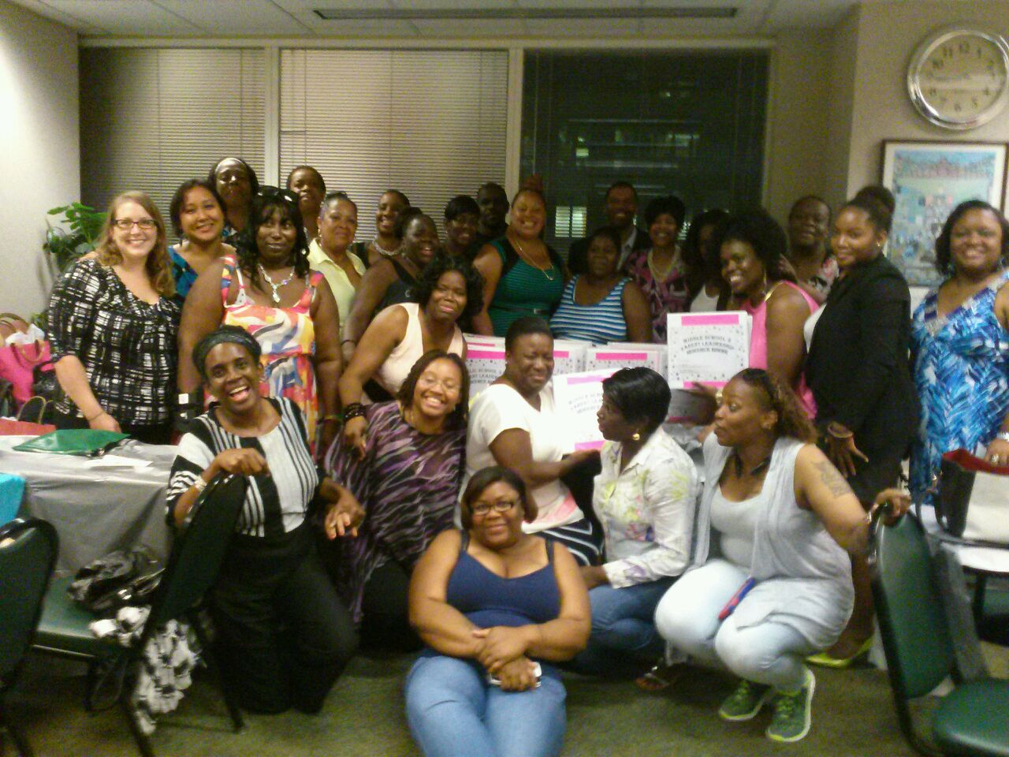
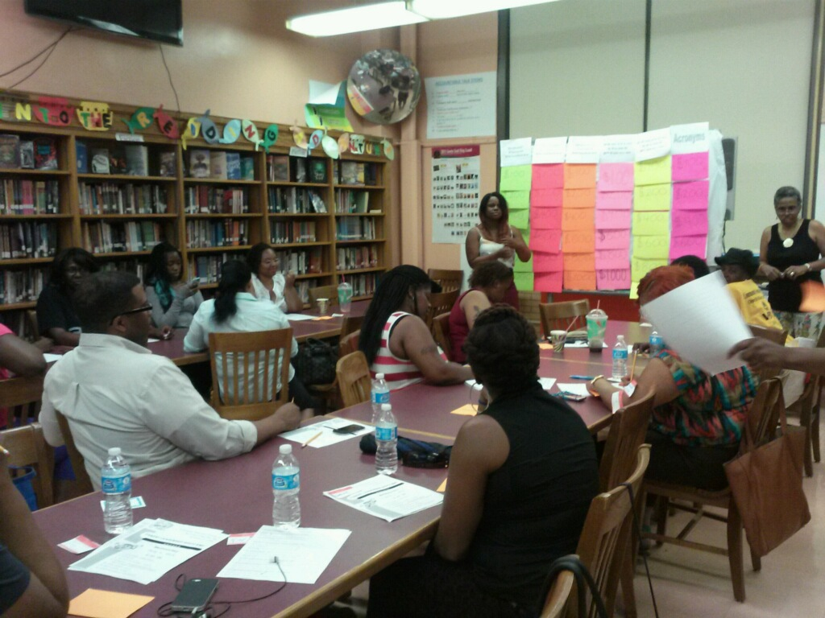
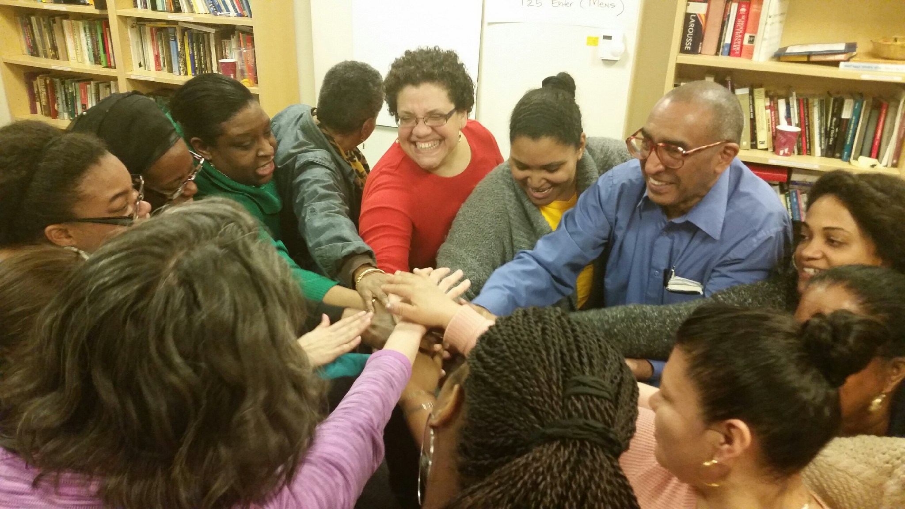
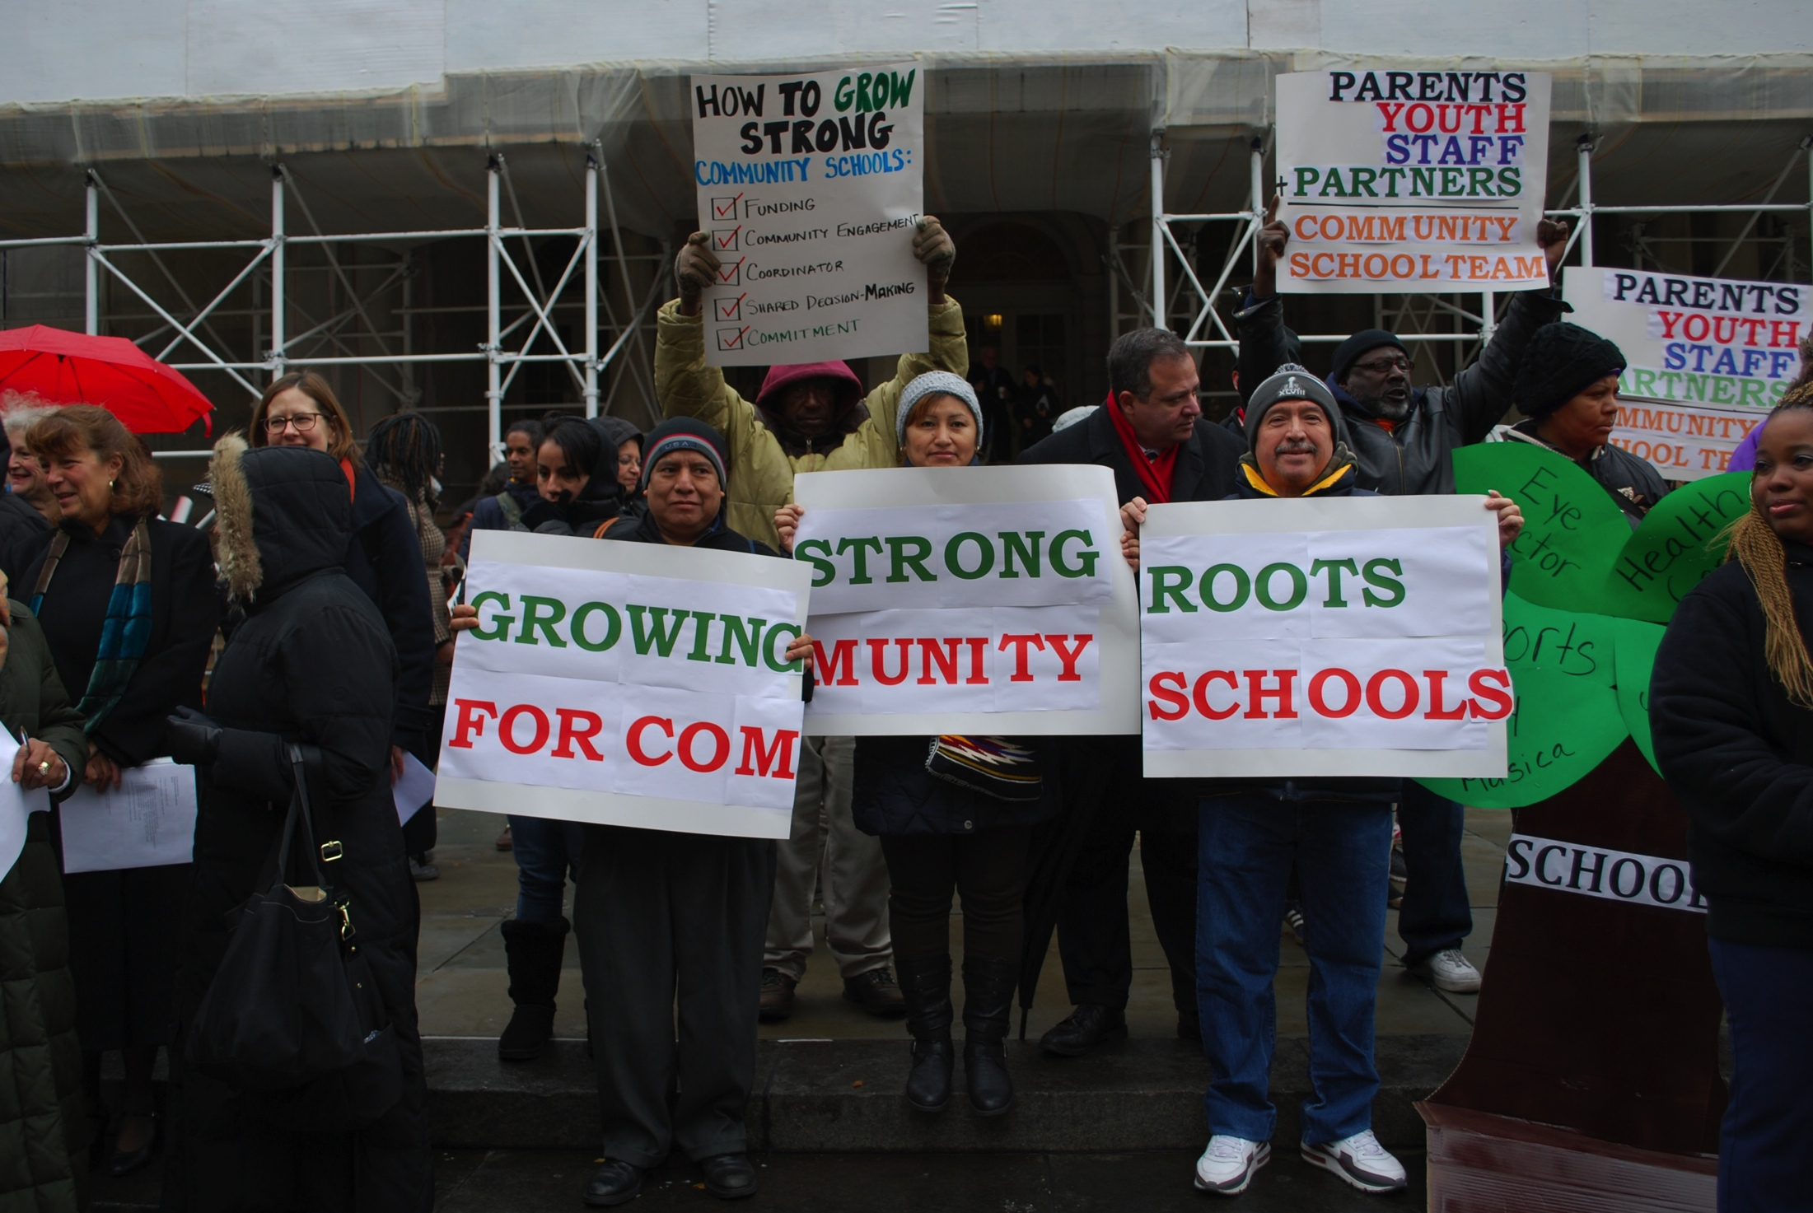
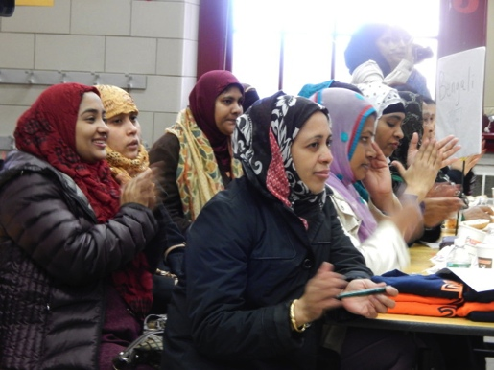
Transformative Parent Engagement in Community Schools
Megan Hester, Director, Education Justice Research and Organizing Collaborative (EJ-ROC),
New York University

Slide 12
Impacts of
Effective Parent Engagement
Improved attendance
Higher academic achievement by any measure
Better social skills with peers
Increased student motivation
Improved behavior at school and home
Sources: Epstein & Sheldon 2002; Henderson & Mapp 2002; Weiss et al. 2009; Bryk & Schneider 2002; Bryk 2010

Slide 13
Qualities of
Effective Parent Engagement
Linked to learning
Systemic and embedded
Relational and asset-based
Dual capacity building
Source: US DOE Dual Capacity Framework for Family-School Partnerships; Harvard Family Research Project

Slide 14
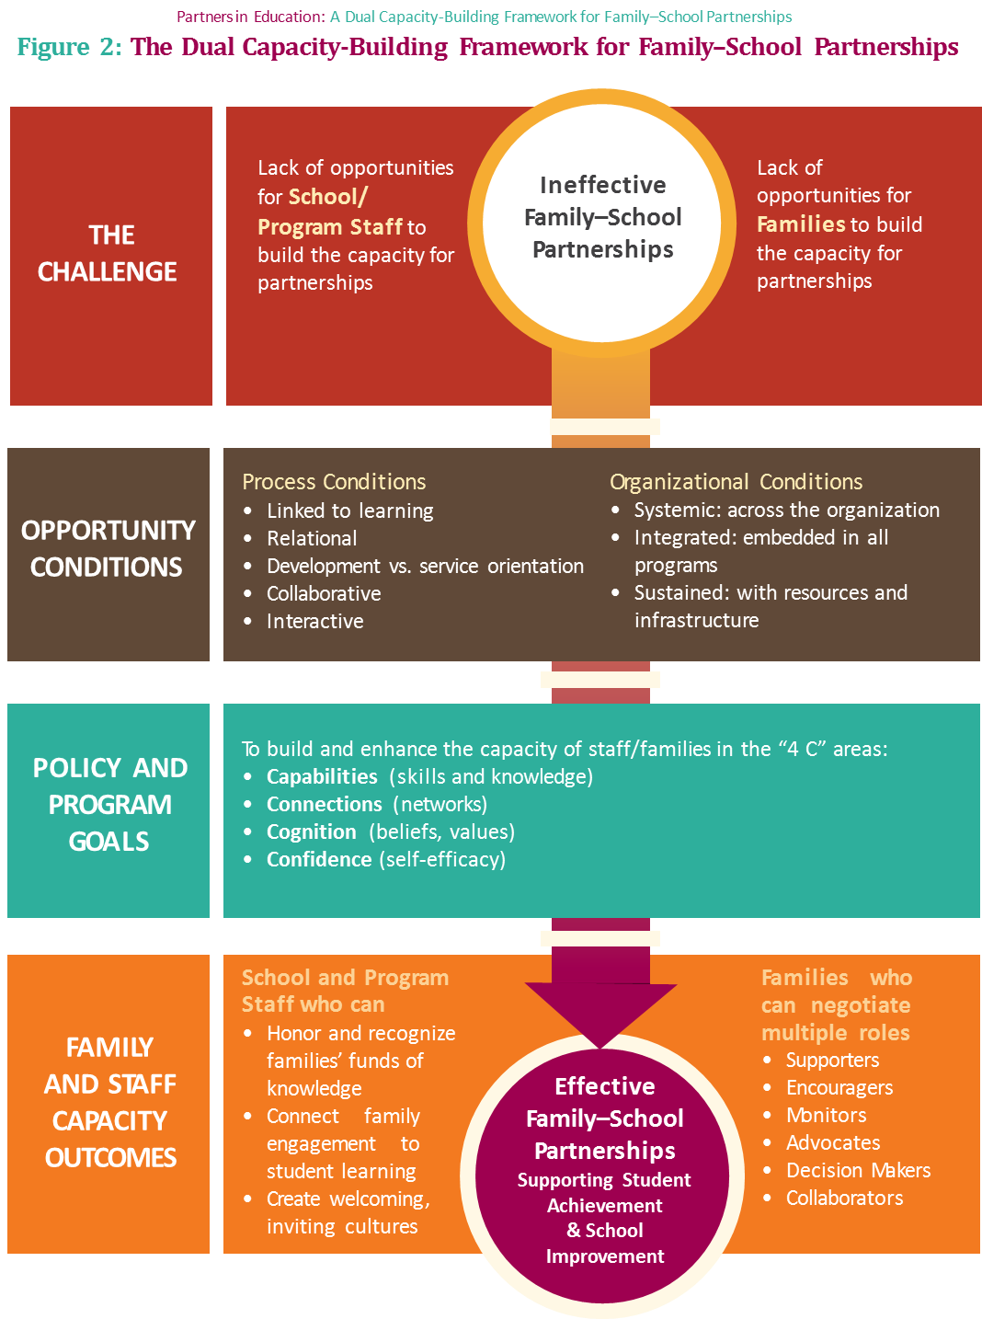

Slide 15
Transformative Parent Engagement
Schools recognize families as assets with untapped knowledge and strengths, and experts on their children and their community
Schools actively develop families’ skills, knowledge and confidence as partners in improving the school
Schools engage parents in meaningful decision-making on a wide range of issues
Schools actively build the capacity of school staff to engage effectively with families

Slide 16
Transactional? Or Transformative?
TRADITIONAL PARENT ENGAGEMENT | TRANSFORMATIVE PARENT ENGAGEMENT
Parents are helpers with the plans that the principal and school staff develop | Parents are equal partners in developing vision and plans for the school
Communication with parents is passive and impersonal, mainly through fliers, emails and robocalls | Communication with parents is active and personal, ie. face-to-face outreach, home visits, personal phone calls, etc.
Parents are seen as problems to be solved and addressed | Parents are seen as problem-solvers who can help address challenges
Focus on families’ deficits: what they aren’t doing, what they don’t have, what are the gaps and challenges | Focus on families’ assets: their strengths, skills and resilience; the progress made and possibilities ahead

Slide 17
Transformative Parent Engagement in Practice
Collaborative school governance
Parent leadership development
Effective outreach methods
Opportunities for school to learn about school community
Community forums
Culturally responsive education

Slide 18




Research-Based Models: Examples
Parent-Teacher Home Visits
Academic Parent-Teacher Teams
Parent Mentor Program
Abriendo Puertas

Slide 19
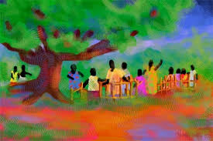

Slide 20
The Imagineers of
Community School Leadership:
Cliff Hong and Richard Zapien
By Lynda Tredway & Matthew Militello
Speaker: Lynda Tredway, Senior Associate for the Leaders for Today and Tomorrow Project, IEL

Slide 21
IMAGINEER = IMAGination engINEERing
CASE STUDIES of TWO IMAGINEER PRINCIPALS
Creative
Intuitive
Instructional
Logistical

Slide 22
CROSSWALK
Community Schools & Community Learning Exchanges
Community Learning Exchange Axioms | Community School Criteria
Learning and leadership are a dynamic social process | Engaging students and adults in their learning Emphasizing high quality teaching, not high stakes testing
Conversations are critical and central pedagogical processes | Using culturally responsive curricula, discipline practices, pedagogy and practices
The people closest to the issues are best situated to discover answers to local concerns | Implementing wrap-around supports and opportunities Asset-based inventory of school
Crossing boundaries enriches development and the educational process | Ensuring shared and collective leadership
Hopes and change are built on assets and dreams of locals and their communities | Using the wisdom and power of place as guideposts for change

Slide 23


Something changes in me when I witness someone’s courage… Holly Near
Intuition Experience Knowledge
Time for building trust and capacity – abstract resource
View leadership as distributed and collaborative
Structures: Teacher, coordinator, and student time - overlap
Celebrate small wins
Be entrepreneurial = innovative, risk-taking, tactical
Go slow to go fast
Be COURAGEOUS

Slide 24
Re-imagining Teacher Preparation: The Role of Community Schools
JoAnne Ferrara, Professor, Associate Dean for Undergraduate Advising, Childhood Education, Manhattanville College

Slide 25

The Community School/PDS Mission
A strategy focused on four overarching goals
Educator Preparation
Professional Development
Student Achievement
Practitioner Inquiry

Slide 26
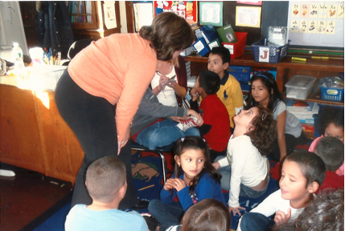
Rationale for Embedding Teacher Preparation in a Community School
Scaffolded, integrated university course work and school-based classroom experiences
Develop cadres of teachers prepared in the community school strategy
Create assets-based approach to teaching
Develop a broader socio-political
consciousness
Identity transformation(becoming a teacher)

Slide 27
In a Community School ,Pre-service Teachers . .
Co-teach with classroom teachers and college faculty
Work with families
Develop activities to meet the needs of the school and the community
Understand students’ lived experiences
Build community partners’ capacity to engage with pre-service teachers
Embrace a whole child education philosophy
Serve as tutors, mentors, researchers
Engage in cross-boundary leadership

Slide 28

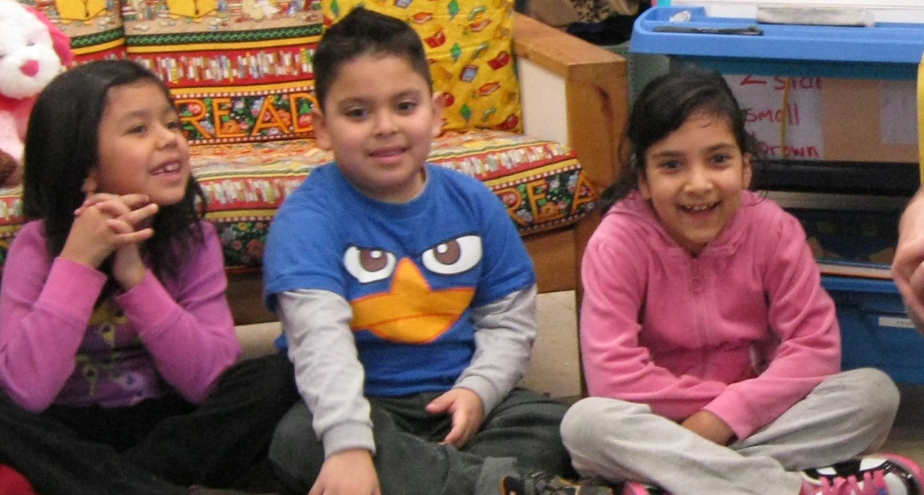

I recognize that in order to effectively educate a child I need to look at the whole picture, not just academics. Each social, emotional and academic component of a child’s education is like a puzzle piece. When each piece connects with the next a beautiful solid whole puzzle is created.
As a teacher I want to help create each student’s unique puzzle. . .

Slide 29
Thank you for watching!

Slide 30
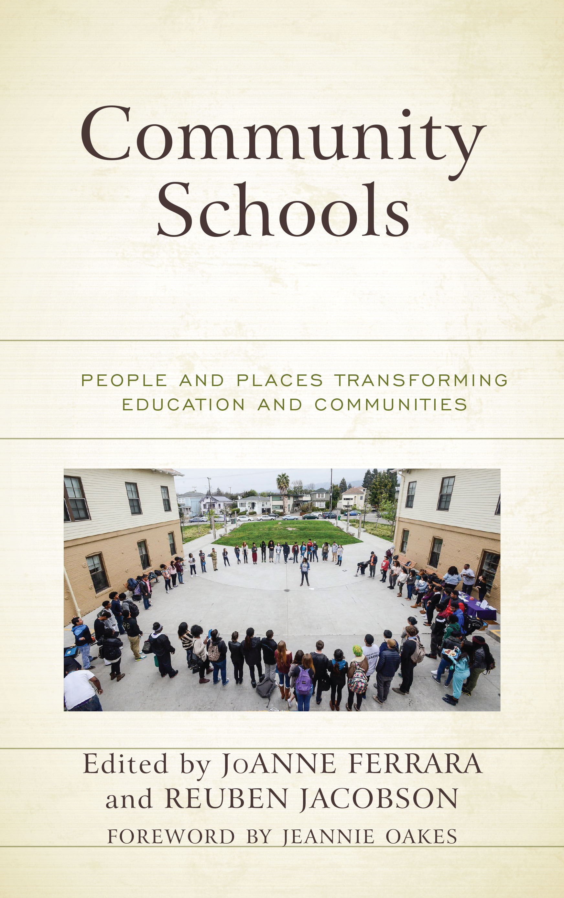
Community Schools: People and Places Transforming Education and Communities by editors JoAnne Ferrara and Reuben Jacobson is now available.
Click here and use the code RLEGEN19 to receive a 20% discount.
It is also available on Amazon.

